Slide 1
FracHack Application
By the Real-Time-Hacks

Slide 2

Core Features:
Real-time Monitoring of Completions Jobs
Automates Operational Decisions
Incentivizes Frac performance for PIC’s
Gamified approach aimed to improve user engagement and job performance
Device agnostic
Notes:
Application logic provides real-time instructions based on KPI statuses
Compares performance of pic’s against each other creating a competitive environment

Slide 3

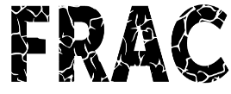
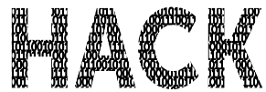



Architecture
Mobile App (Ionic)
Azure Web API
OData
SignalR
PI Web API
Subscriptions
Azure Service Bus
Azure Functions
Pull/Push
Events

Slide 4
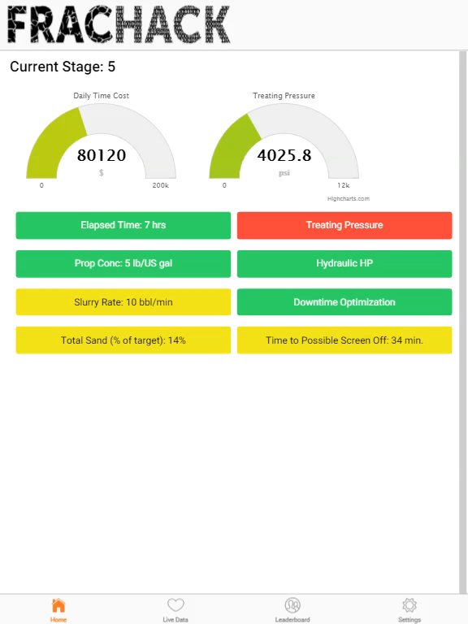
Demo

